Slide 1


Akshat Prakash
18th July, 2022

Slide 2

Outline
Executive Summary
Introduction
Methodology
Results
Conclusion
Appendix

Slide 3
Executive Summary
Summary of Our aim was to find the factors that affected the success of SpaceX missions, such as the rocket design, payload, etc
For Data collection, we use SpaceX web API to retrieve raw Data as well as SpaceX wikipedia page.
We fit data into classification models: Logistic Regression, Decision Tree, Support Vector Machine, k-Nearest Neighbors and find which model is best for predicting landing outcome.

Slide 4
Introduction
SpaceX has the aim to make space flights more cheaper by first stage landings.
We will predict landing outcomes on data of previous launces

Slide 5

Section 1

Slide 6
Methodology
Executive Summary
Data collection methodology:
• SpaceX web API or SpaceX Wikipedia web scrapping
Perform data wrangling
Dealt with missing values and created landing category variable
Perform exploratory data analysis (EDA) using visualization and SQL
Perform interactive visual analytics using Folium and Plotly Dash
Perform predictive analysis using classification models
Grid search to train, test and tune classification models

Slide 7
Data Collection
We use SpaceX web API or SpaceX Wikipedia web scrapping for data collection.
SpaceX Web API
SpaceX Wikipedia
Raw Dataset

Slide 8
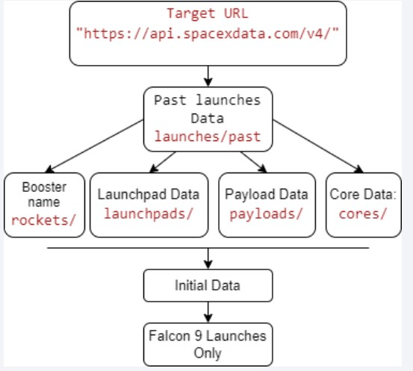
Data Collection – SpaceX API
Present your data collection with SpaceX REST calls using key phrases and flowcharts
https://github.com/nghhai96/DataScience-CapstoneProject/blob/bbb7684e9a49ca83 9157b82a96eab596f33c675b/Da ta%20Collection.ipynb
Place your flowchart of SpaceX API calls here

Slide 9
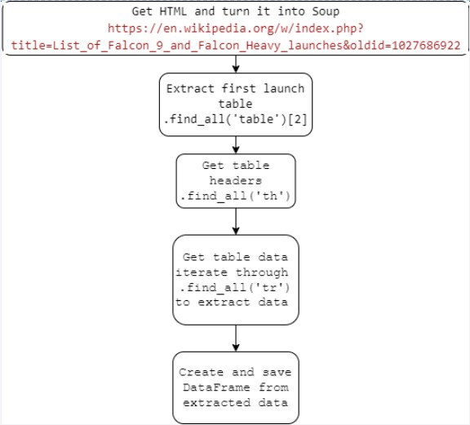
Data Collection - Scraping
Present your web scraping process using key phrases and flowcharts
• https://github.com/nghhai96 /Data-Science-CapstoneProject/blob/fef3b71c471b7 8532beef5f24f3c449f7b23a 760/jupyter-labswebscraping.ipynb
Place your flowchart of web scraping here

Slide 10
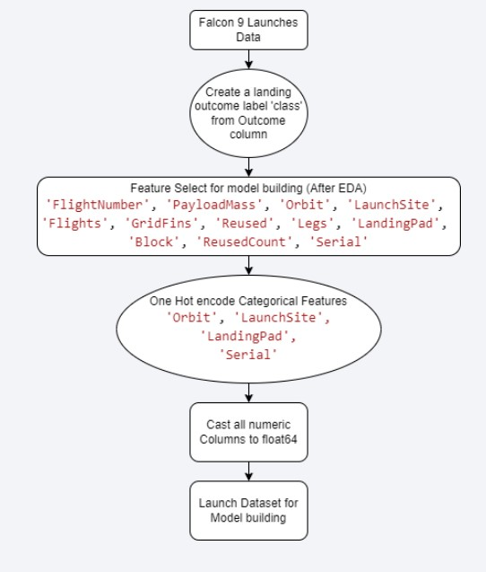
Data Wrangling
Describe how data were processed
You need to present your data wrangling process using key phrases and flowcharts
https://github.com/nghhai96/DataScience-CapstoneProject/blob/bbb7684e9a49ca839157 b82a96eab596f33c675b/labs-jupyterspacex-Data%20wrangling.ipynb

Slide 11
EDA with Data Visualization
Summarize what charts were plotted and why you used those charts
Payload Mass vs. Flight Number vs Launch Outcome Scatter Plot:
• First stage is more likely to land in later launches
• Seems the more massive the payload, the less likely First stage returns
Launch Site vs. Flight Number vs. Launch Outcome:
• Successful First Stage return improves over launches for all 3 sites
• CCAFS SLC 40 site is used for launches more often than the other 2 sites
• https://github.com/nghhai96/Data-Science-CapstoneProject/blob/bbb7684e9a49ca839157b82a96eab596f33c675b/j upyter-labs-eda-dataviz.ipynb

Slide 12
EDA with SQL
https://github.com/nghhai96/Data-Science-CapstoneProject/blob/303c003201170fa2aa5cec9baf3e38f7b21fb71b/jupyter-labs-eda-sqlcoursera_sqllite.ipynb
• Task 1: Get Launch Site names
• Task 2: Get data with launch sites names starting with CCA
• Task 3: Get total Payload Mass carried by booster launched by NASA (CRS)
• Task 4: Get average Payload Mass carried by booster version F9 v1.1
• Task 5: Get the day of the first successful landing outcome in the ground pad
• Task 6: Get Booster Versions with a payload range of 4000kg to 6000kg and successfully land on a drone ship.
• Task 7: Get the mission outcome counts
• Task 8: Get booster versions that carried the maximum payload
• Task 9: Get data on failed landing onto a drone ship in the year 2015
• Task 10: Rank the count of successful landing outcomes between the date 04-06-2010 and 20-03-2017 in descending order

Slide 13
Build an Interactive Map with Folium
Added objects to Map:
Launch Sites, and their names
Marker Cluster for each launch site to illustrate the successful and failed landings, for easily visualizing the number of launches and their landing success rate
Distance from site CCAFS LC – 40 to the nearest City, Highway, Railroad, and Coast, to understand the importance of launch site location. Launch sites are generally far from cities and near the coast for safety reasons. They are near highways and railroads for efficient building materials transport
• https://github.com/nghhai96/Data-Science-CapstoneProject/blob/fa704123b178f32b452b1e54dd8474027a89ad8d/lab_jupyter_launc h_site_location.ipynb

Slide 14
Build a Dashboard with Plotly Dash
A drop-down menu for choosing a site’s successful landing rate on a pie chart. If the all-sites option is selected, the percentage of successful landings for each site is displayed on a pie chart
A payload range slider as input
A graph that displays the correlation between Payload and Success for selected sites/site with a selected payload range. The interactive graph lets the user see how payload mass and site location affects the landing success rate
Add the GitHub URL of your completed Plotly Dash lab, as an external reference and peer-review purpose
https://github.com/nghhai96/Data-Science-CapstoneProject/blob/fa704123b178f32b452b1e54dd8474027a89ad8d/dash_interactive.p y

Slide 15
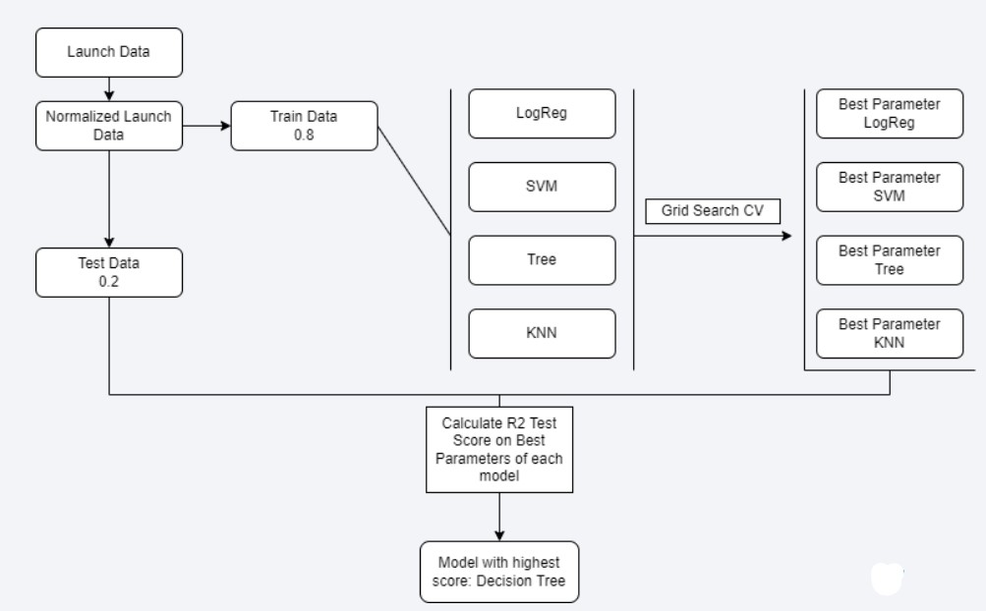
Predictive Analysis (Classification)
Using Grid Search CV for Logistic Regression, Decision Tree Classification, Support Vector Machine, and K-nearest Neighbors to find which model has the best Test Score
https://github.com/nghhai96 /Data-Science-CapstoneProject/blob/ef52dff6eb57b 695ea245410075d333d1 1537995/SpaceX_Machine %20Learning%20Prediction _Part_5.ipynb

Slide 16
Results
Exploratory data analysis results
Interactive analytics demo in screenshots
Predictive analysis results

Slide 17

Section 2

Slide 18
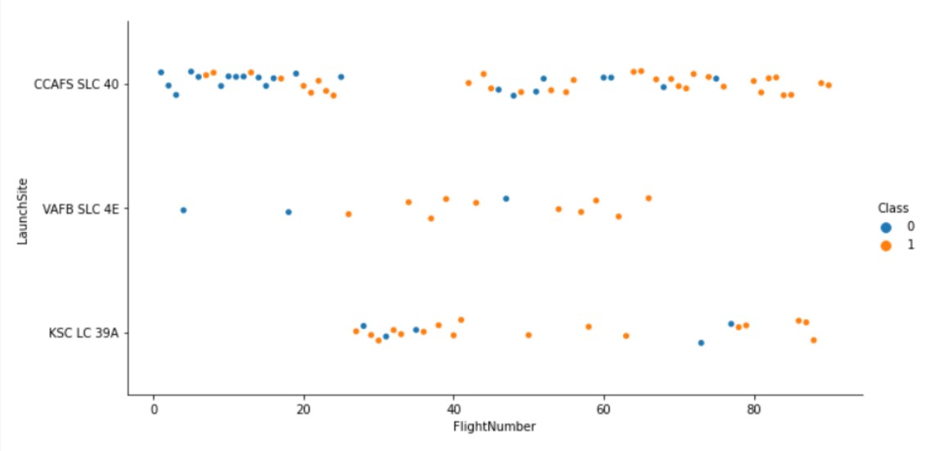
Flight Number vs. Launch Site

Slide 19
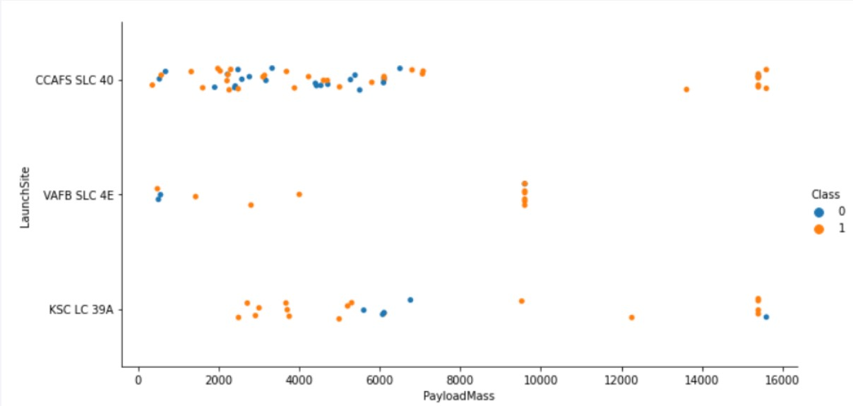
Payload vs. Launch Site

Slide 20
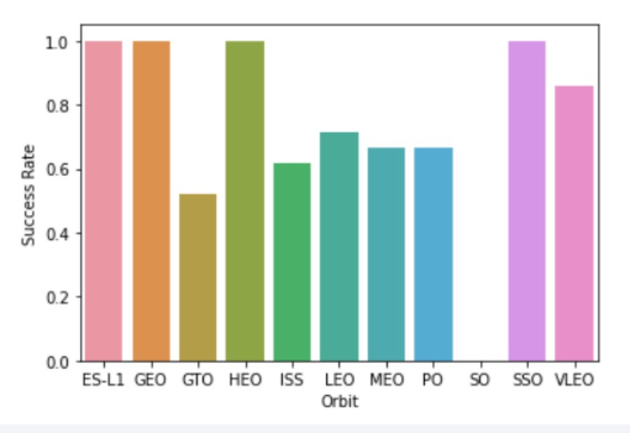
Success Rate vs. Orbit Type

Slide 21
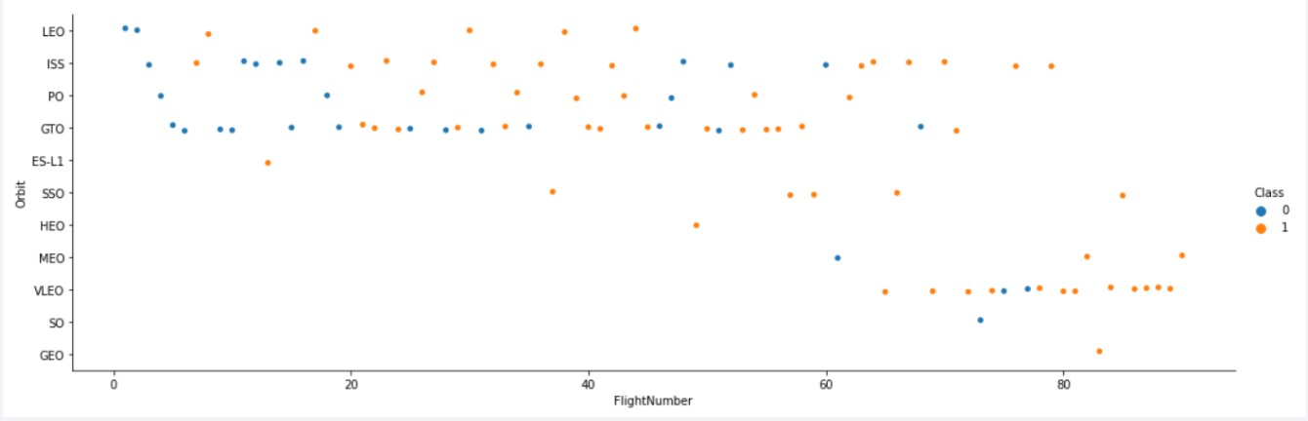
Flight Number vs. Orbit Type

Slide 22
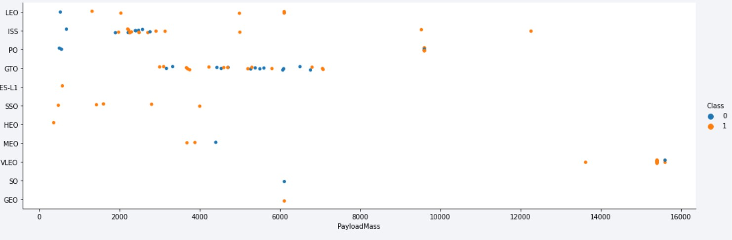
Payload vs. Orbit Type

Slide 23
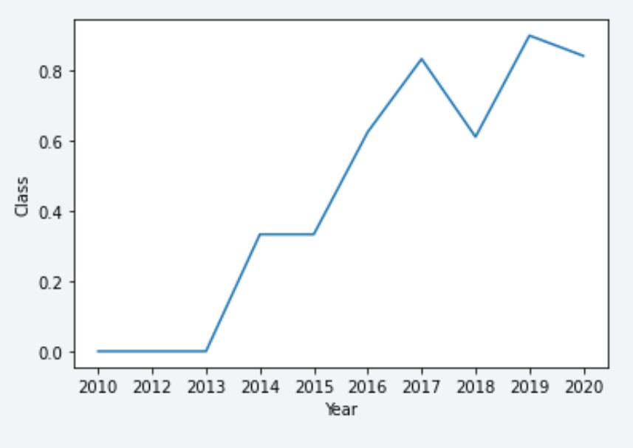
Launch Success Yearly Trend

Slide 24
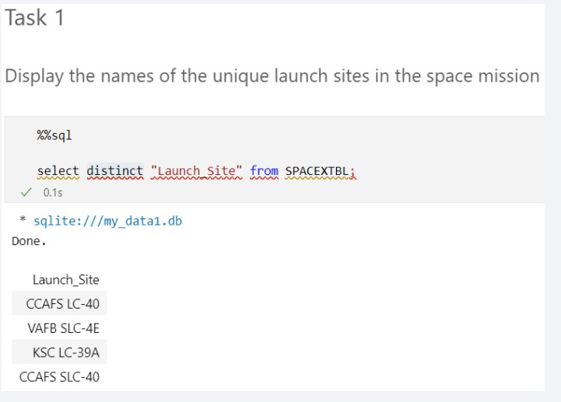
All Launch Site Names
Use distinct call on “Launch Site” column

Slide 25
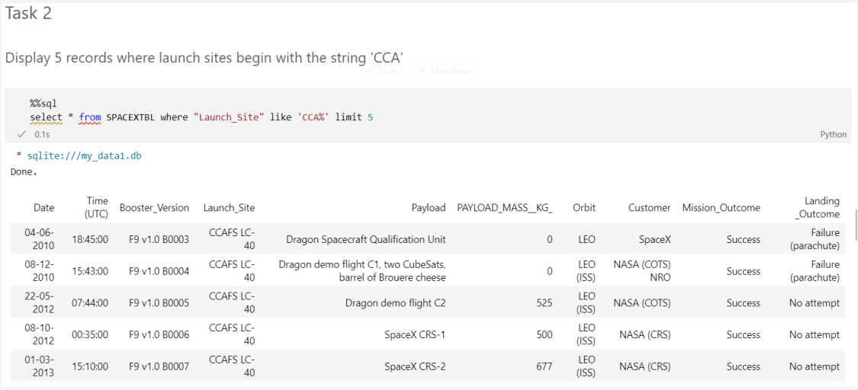
Launch Site Names Begin with 'CCA'
Use LIKE to find word string ‘CCA%’ in “Launch Site” column

Slide 26
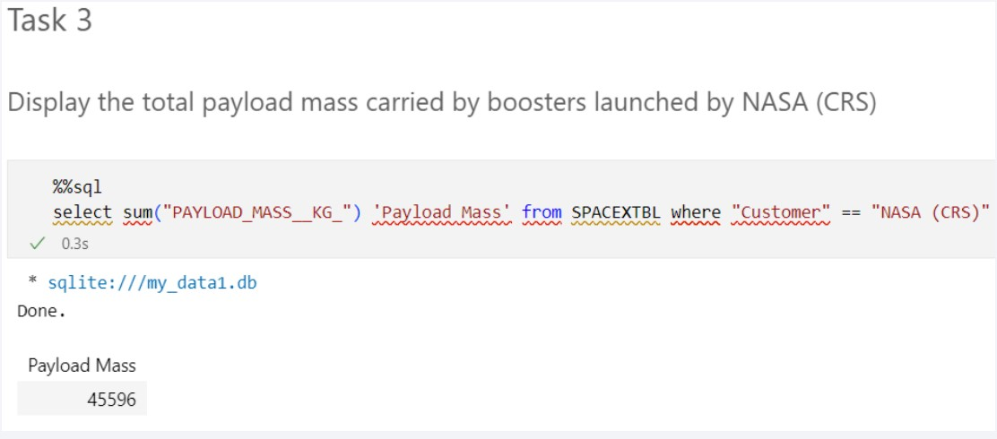
Total Payload Mass
Use sum() method on “Payload mass kg” column with filter customer == NASA (CRS)

Slide 27
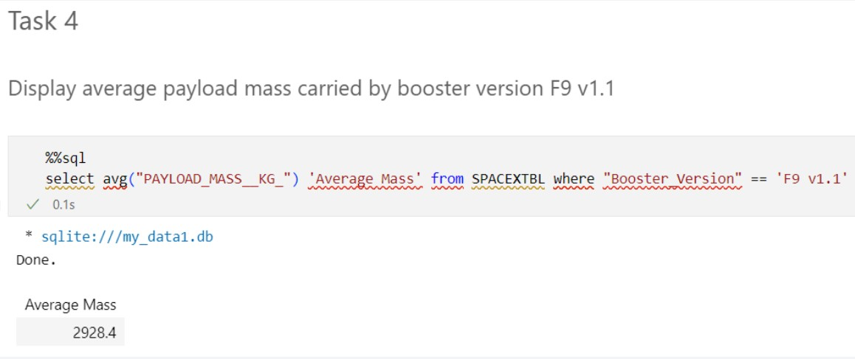
Average Payload Mass by F9 v1.1
Use avg() method on “Payload mass kg” column with filter booster version == F9 v1.1

Slide 28
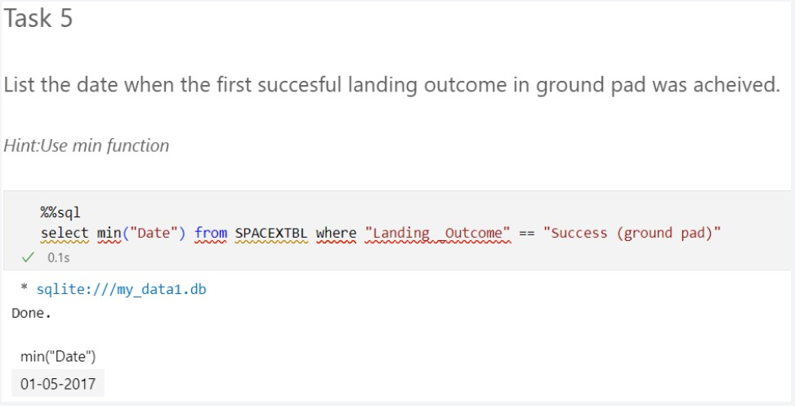
First Successful Ground Landing Date
Use min() function on “Date” column with filter landing outcome == Success (ground pad)

Slide 29
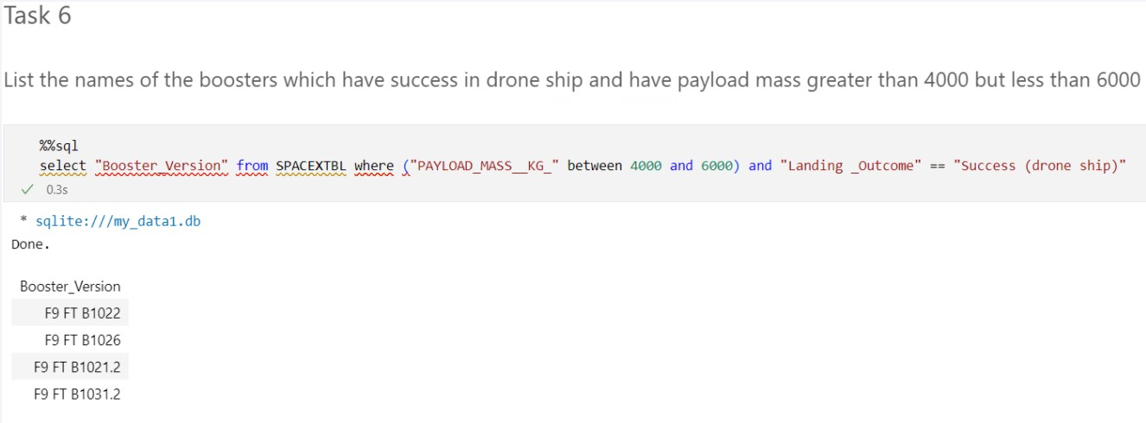
Successful Drone Ship Landing with Payload between 4000 and 6000
Get “Booster Version” column with filter “payload mass kg” between 4000 and 6000, and landing outcome == Success (drone ship)

Slide 30
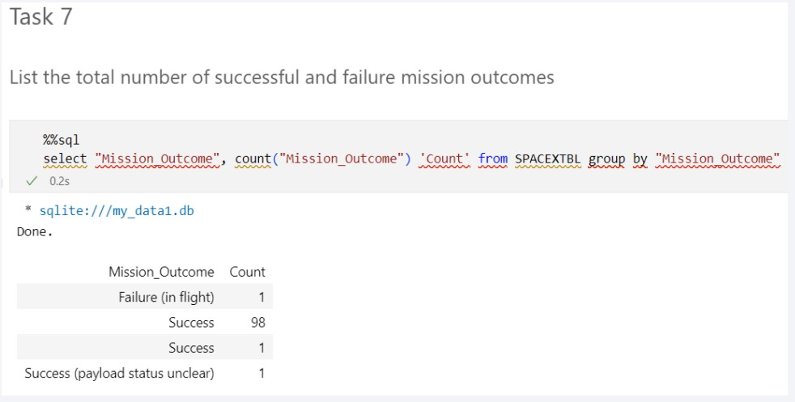
Total Number of Successful and Failure Mission Outcomes
Use Count() on Mission Outcome column, with group by methods on Mission Outcome

Slide 31
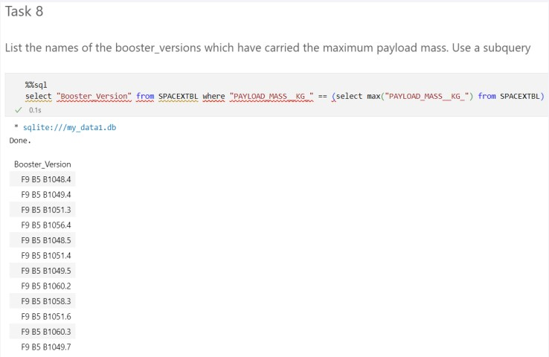
Boosters Carried Maximum Payload
Use subquery max() to filter Booster Versions where they have max payload

Slide 32
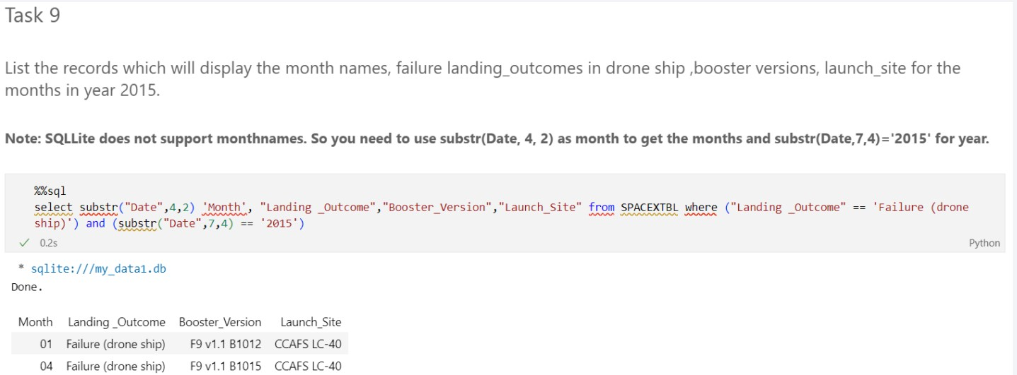
2015 Launch Records
Use substr() method to extract month and year for filtering. Filters landing outome == ‘Failure (drone ship)’, year. Display booster version and the month it is used

Slide 33
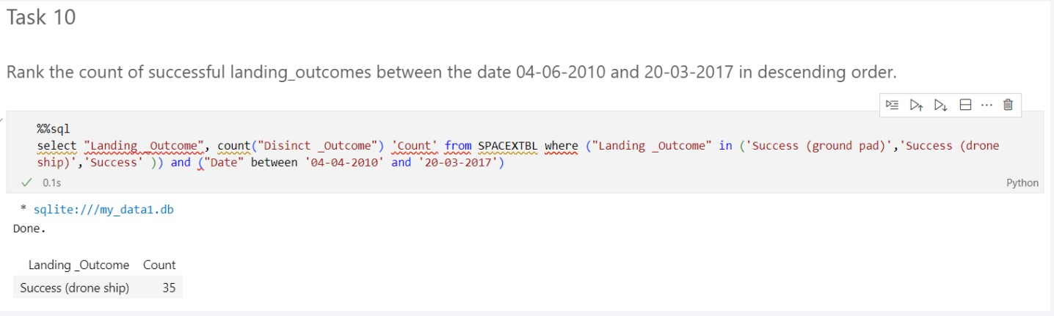
Rank Landing Outcomes Between 2010-06-04 and 2017-03-20
Use a combination of count(), group by, filtering in (), and filtering date between

Slide 34

Section 3

Slide 35
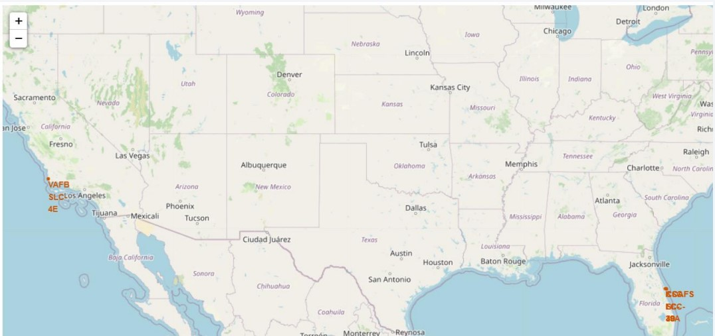
Launch Site
Launch Sites are near the coast for safety reasons, and near the equator line for better launch

Slide 36
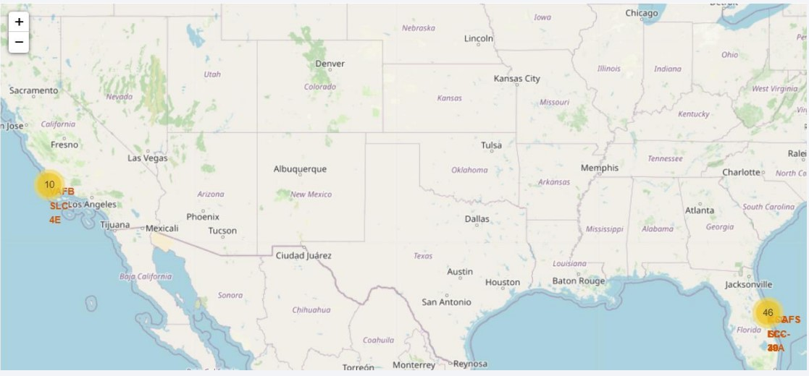
Launch Site Landing Success Rate
There are more launches on the west coast, as it is nearer to the equator line

Slide 37
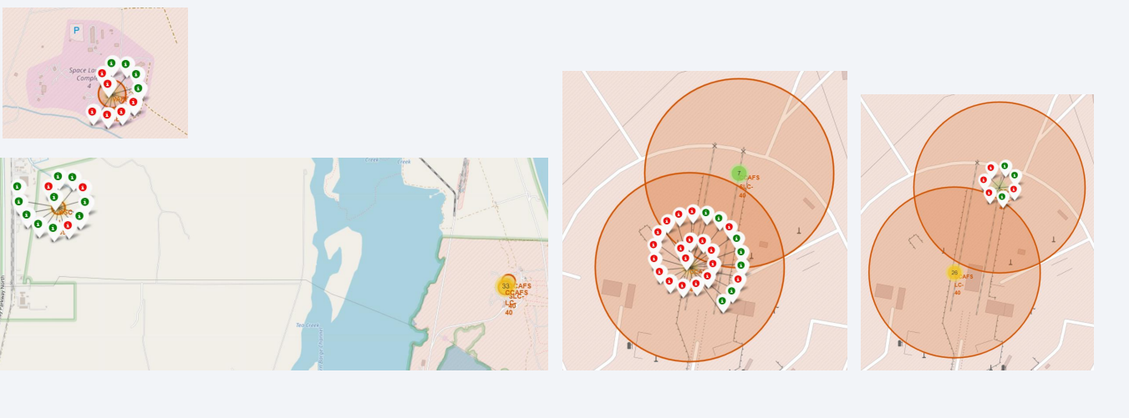
Launch Sites Landing Success rate
• Launch Site KSC LC 39A has the highest success rate

Slide 38

Section 4

Slide 39
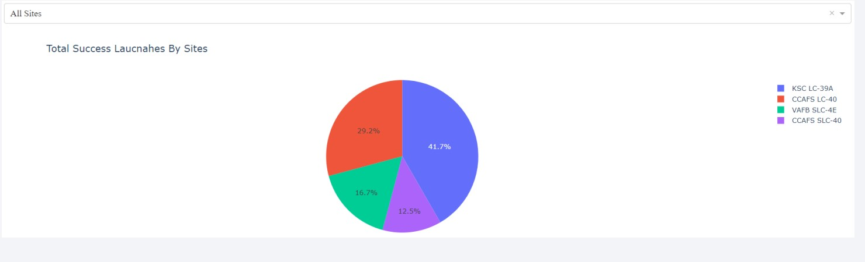
All Sites Contribution of Success Landings
• KSC LC-39A has the most number of success landings

Slide 40
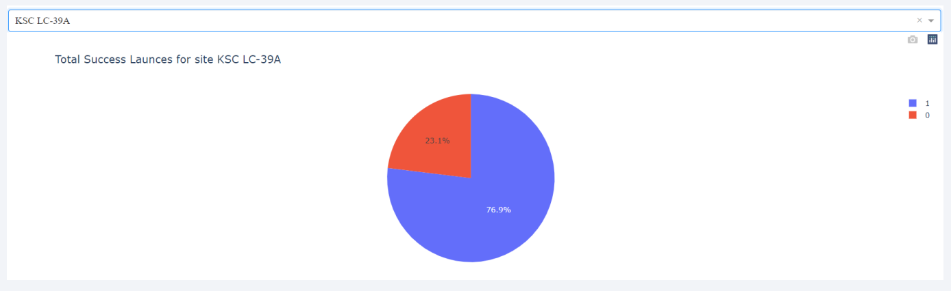
KSC LC-39A Success Landing Percentage
KSC LC-39A launching site has the highest success landing percentage

Slide 41
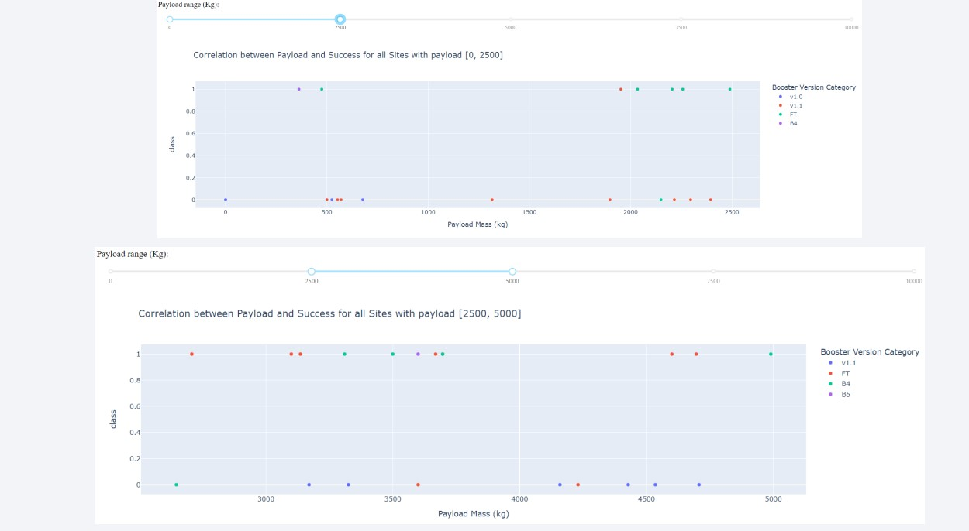
Success Landings with different Booster Versions and Payloads

Slide 42
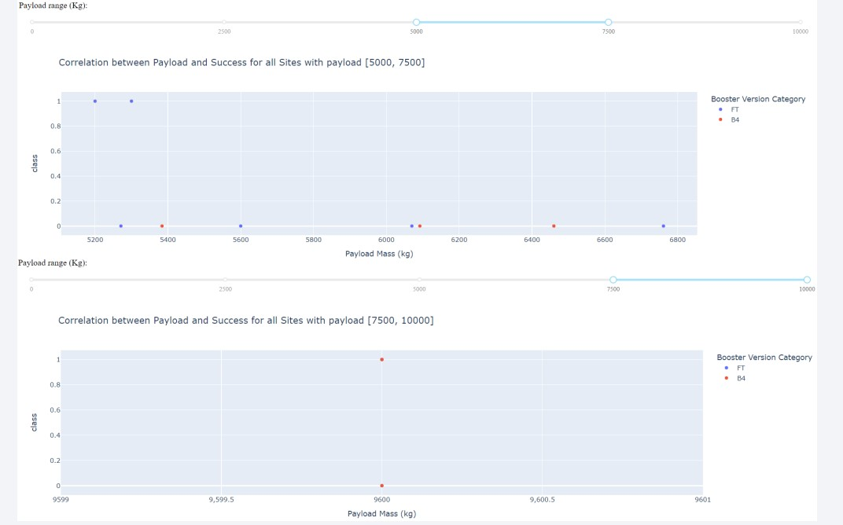
Success Landings with different Booster Versions and Payloads

Slide 43
Success Landings with different Booster Versions and Payloads
Payload range [0,2500]: Highest number of success landings Booster Version: FT
Payload range [2500,5000]: Highest number of success landings Booster Version: FT
Payload range [5000,7500]: Highest number of success landings Booster Version: FT
Payload range [7500,10000]: Highest number of success landings Booster Version: B4
Conclusion: Version Booster FT has the highest success rate

Slide 44

Section 5

Slide 45
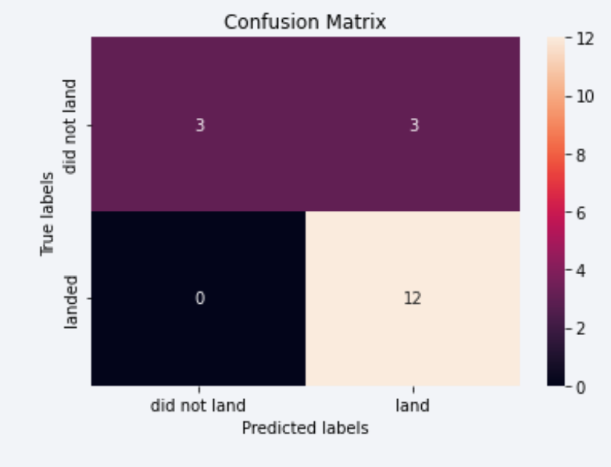
Confusion Matrix
Decision Tree can distinguish between different classes. However the True Positive Rate (TRP) is only 0.5

Slide 46
Conclusions
Launch Site with highest success landing rate and highest number and success landings: KSC LC-39A
Highest Landing success rate for various payload masses: FT
Launch Site position: Far from cities and near the coast for safety reasons (In case when rocket fails, it is better for it to fall into the water and far from population-dense areas). Near railroads, highways, and coast for better rocket-building-materials transportation
Best model for Landing predictions: Decision Tree. However, TPR is low (0.5). More data is needed for a better fit. Example: Weather conditions (wind, temperature, humidity, etc..)

Slide 47
Appendix
Raw Data Set: https://github.com/nghhai96/Data-Science-CapstoneProject/blob/ef52dff6eb57b695ea245410075d333d11537995/dataset_part_1.csv
Dataset for model fitting: https://github.com/nghhai96/Data-Science-CapstoneProject/blob/ef52dff6eb57b695ea245410075d333d11537995/dataset_part_3.csv

Slide 48


